Slide 1
Service Layer and Spring Framework

Slide 2
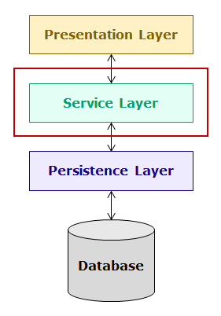
Introduction to Service Layer
The service layer of an enterprise application is the layer in which the business logic is implemented. It is the heart of enterprise applications as it contains the business processes of the application. It interacts with the presentation layer and the persistence layer. In this course, you will learn the development of service layer of enterprise applications using Spring Boot.

Slide 3
In this course, you will understand the concepts of Spring Boot and service layer by developing a banking application named hndBank containing multiple modules. One of the modules of this application is the Customer module and one of the most common feature of any application and also this application is that the customer should be able to login to the application using valid credentials.
To login, the business logic is to validate the credentials entered by the customer against the details stored in the database. On successful validation, the customer should be allowed to use the application. If credentials are invalid, error page should be displayed.
To implement this functionality of login, the following classes need to be implemented in the application:
UserInterface – The customer will interact with the application using a web-based user interface. This interface will interact with the CustomerLoginController class. In this course, for simplicity, the web interface will be replaced with this class.
CustomerLoginController – This class will interact with the user interface and the CustomerLoginServiceImpl class of service layer.

Slide 4
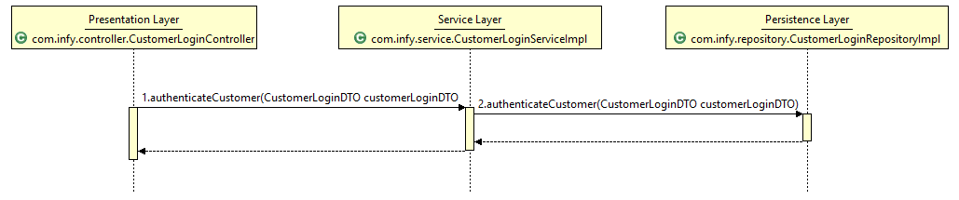
CustomerLoginServiceImpl – The business logic will be implemented in this class. It will interact with the CustomerLoginController of the presentation layer and CustomerLoginRepositoryImpl class of the persistence layer.
CustomerLoginRepositoryImpl – This class is a persistence layer class and will interact with the database and CustomerLoginServiceImpl class of service layer.
CustomerLoginDTO – This is a DTO (Data Transfer Object) class which is used to transfer data across different layers.
When the customer enters the login credentials, the data will flow from CustomerLoginController to CustomerLoginServiceImpl and then to CustomerLoginRepositoryImpl class as follows:

Slide 5
The implementation of the various classes are as follows:
1. CustomerLoginDTO class
package com.hnd.dto;
public class CustomerLoginDTO {
private String loginName;
private String password;
//getter and setter methods
}
2. CustomerLoginRepository interface
package com.hnd.repository;
import com.hnd.dto.CustomerLoginDTO;
public interface CustomerLoginRepository {
public CustomerLoginDTO getCustomerLoginByLoginName(String loginName);
}

Slide 6
3. CustomerLoginRepositoryImpl class
package com.hnd.repository;
import java.util.HashMap;
import java.util.Map;
import com.hnd.dto.CustomerLoginDTO;
public class CustomerLoginRepositoryImpl implements CustomerLoginRepository {
public CustomerLoginDTO getCustomerLoginByLoginName(String loginName) {
Map<String, String> customerCredentials = new HashMap<String, String>();
customerCredentials.put("robin", "robin123");
customerCredentials.put("harry", "harry123");
customerCredentials.put("garry", "garry123");
customerCredentials.put("monica", "monica123");
CustomerLoginDTO customerLogin = new CustomerLoginDTO();
customerLogin.setLoginName(loginName);
customerLogin.setPassword(customerCredentials.get(loginName));
return customerLogin;
}
}

Slide 7
In this class, data has been stubbed for ease of learning. In actual implementation, this class will contain the code for interacting with the database.
4. CustomerLoginService interface
package com.hnd.service;
import com.hnd.dto.CustomerLoginDTO;
import com.hnd.exception.hndBankException;
public interface CustomerLoginService {
public String authenticateCustomer(CustomerLoginDTO customerLoginDTO) throws hndBankException;
}
NOTE: hndBankException is a user-defined exception class.
5. CustomerLoginServiceImpl class

Slide 8
package com.hnd.service;
import com.hnd.dto.CustomerLoginDTO;
import com.hnd.exception.hndBankException;
import com.hnd.repository.CustomerLoginRepository;
import com.hnd.repository.CustomerLoginRepositoryImpl;
public class CustomerLoginServiceImpl implements CustomerLoginService {
private CustomerLoginRepository customerLoginRepository;
public String authenticateCustomer(CustomerLoginDTO customerLoginDTO) throws hndBankException {
String toReturn = null;
customerLoginRepository = new CustomerLoginRepositoryImpl();
CustomerLoginDTO customerLoginFromRepository =
customerLoginRepository.getCustomerLoginByLoginName(customerLoginDTO.getLoginName());
if (customerLoginDTO.getPassword().equals(customerLoginFromRepository.getPassword())) {
toReturn = "SUCCESS";
} else {
throw new hndBankException("Service.WRONG_CREDENTIALS");
}
return toReturn;
}
}

Slide 9
6. CustomerLoginController class
package com.hnd.controller;
import com.hnd.dto.CustomerLoginDTO;
import com.hnd.exception.hndBankException;
import com.hnd.service.CustomerLoginService;
import com.hnd.service.CustomerLoginServiceImpl;
public class CustomerLoginController {
private CustomerLoginService customerLoginService;
public String authenticateCustomer(CustomerLoginDTO customerLoginDTO) throws hndBankException {
customerLoginService=new CustomerLoginServiceImpl();
return customerLoginService.authenticateCustomer(customerLoginDTO);
}
}
7. UserInterface class
The customer interacts with the application using a web user interface. The web interface interacts with the CustomerLoginController class. For simplicity, the web interface is replaced with the following UserInterface class:

Slide 10
package com.hnd.ui;
import org.apache.commons.configuration2.PropertiesConfiguration;
import org.apache.commons.configuration2.builder.fluent.Configurations;
import org.apache.commons.logging.Log;
import org.apache.commons.logging.LogFactory;
import com.hnd.controller.CustomerLoginController;
import com.hnd.dto.CustomerLoginDTO;
public class UserInterface {
private static final Log LOGGER = LogFactory.getLog(UserInterface.class);
public static void main(String[] args) throws Exception {
PropertiesConfiguration config=new Configurations().properties("configuration.properties");
try {
CustomerLoginDTO customerLoginDTO = new CustomerLoginDTO();
customerLoginDTO.setLoginName("harry");
customerLoginDTO.setPassword("harry123");
CustomerLoginController customerLoginController = new CustomerLoginController();
String message = customerLoginController.authenticateCustomer(customerLoginDTO);
LOGGER.info(config.getProperty(message));
} catch (Exception exception) {
LOGGER.info(config.getProperty(exception.getMessage()));
}
}
}

Slide 11
Need of Spring Framework
Consider the following implementation of CustomerLoginServiceImpl class:
public class CustomerLoginServiceImpl implements CustomerLoginService {
private CustomerLoginRepository customerLoginRepository = new CustomerLoginRepositoryImpl();
public String authenticateCustomer(CustomerLoginDTO customerLoginDTO) throws hndBankException {
String toReturn = null;
CustomerLoginDTO customerLoginFromRepository =
customerLoginRepository.getCustomerLoginByLoginName(customerLoginDTO.getLoginName());
if (customerLoginDTO.getPassword().equals(customerLoginFromRepository.getPassword())) {
toReturn = "SUCCESS";
} else {
throw new hndBankException("Service.WRONG_CREDENTIALS");
}
return toReturn;
}
}

Slide 12
In this implementation, CustomerLoginServiceImpl depends on CustomerLoginRepository. It also instantiates CustomerLoginRepositoryImpl class which makes it tightly coupled with CustomerLoginRepositoryImpl class. This is a bad design because of the following reasons:
If you want to unit test authenticateCustomer() method, then you need a mock object of CustomerLoginRepository but you cannot use mock object because there is no way to substitute the CustomerLoginRepositoryImpl object that CustomerLoginServiceImpl has. So, testing CustomerLoginServiceImpl becomes difficult.
2.Also, you cannot use a different implementation of CustomerLoginRepository other than CustomerLoginRepositoryImpl because of tight coupling.
So, a more flexible solution is needed where dependencies can be provided externally instead of the dependent creating its own dependencies.
Now, let us see such an implementation of CustomerLoginServiceImpl class.

Slide 13
Consider the following modified implementation of CustomerLoginServiceImpl class:
public class CustomerLoginServiceImpl implements CustomerLoginService {
private CustomerLoginRepository customerLoginRepository;
public CustomerLoginServiceImpl(CustomerLoginRepository customerLoginRepository) {
this.customerLoginRepository = customerLoginRepository;
}
public String authenticateCustomer(CustomerLoginDTO customerLoginDTO) throws hndBankException {
String toReturn = null;
CustomerLoginDTO customerLoginFromRepository =
customerLoginRepository.getCustomerLoginByLoginName(customerLoginDTO.getLoginName());
if (customerLoginDTO.getPassword().equals(customerLoginFromRepository.getPassword())) {
toReturn = "SUCCESS";
} else {
throw new hndBankException("Service.WRONG_CREDENTIALS");
}
return toReturn;
}
}

Slide 14
In this implementation, you can observe that CustomerServiceImpl does not create an object of CustomerRepository. Instead, CustomerServiceImpl is given an object of CustomerRepository when it is instantiated through the constructor argument. You can pass the object of any class that implements CustomerLoginRepository interface at the time of object creation of CustomerServiceImpl class as a constructor argument. This makes CustomerLoginServiceImpl class loosely coupled with CustomerLoginRepositoryImpl class. So, you can now also easily test CustomerServiceImpl class by substituting its CustomerRepositoryImpl object with a mock CustomerRepository. Also, you can use any implementation of CustomerRepository inside CustomerLoginServiceImpl.
This solution is more flexible and easy to test but at the same time, it is tedious to manually wire together the dependencies. Also, if you alter the dependencies, you may have to change huge amount of code.
Instead, a technique called Dependency Injection (DI) is used. It is a technique in which the responsibility of creating, assembling and wiring the dependencies of a dependent class is externalized to the external framework or library called dependency injection (DI) frameworks. Now the control over the construction, wiring and assembly of an object no longer resides with the dependent classes themselves. This reversal of responsibilities is sometimes also known as Inversion of Control(IoC). Dependency injection framework are also called as IoC containers.
There are many third party frameworks which are available for dependency injection such as Spring Framework, Google Guice, Play Framework, etc. In this course, you will be learning about Spring Framework. Besides dependency injection, there are many other advantages of using Spring Framework which you will learn later in this course.

Slide 15
Introduction to Spring Framework
Spring Framework is an open source Java application development framework which supports building all types of Java applications like web applications, database driven applications, enterprise applications and many more. Java applications developed using Spring are simple, easily testable, reusable and maintainable. Some of the features are described below.

Slide 16
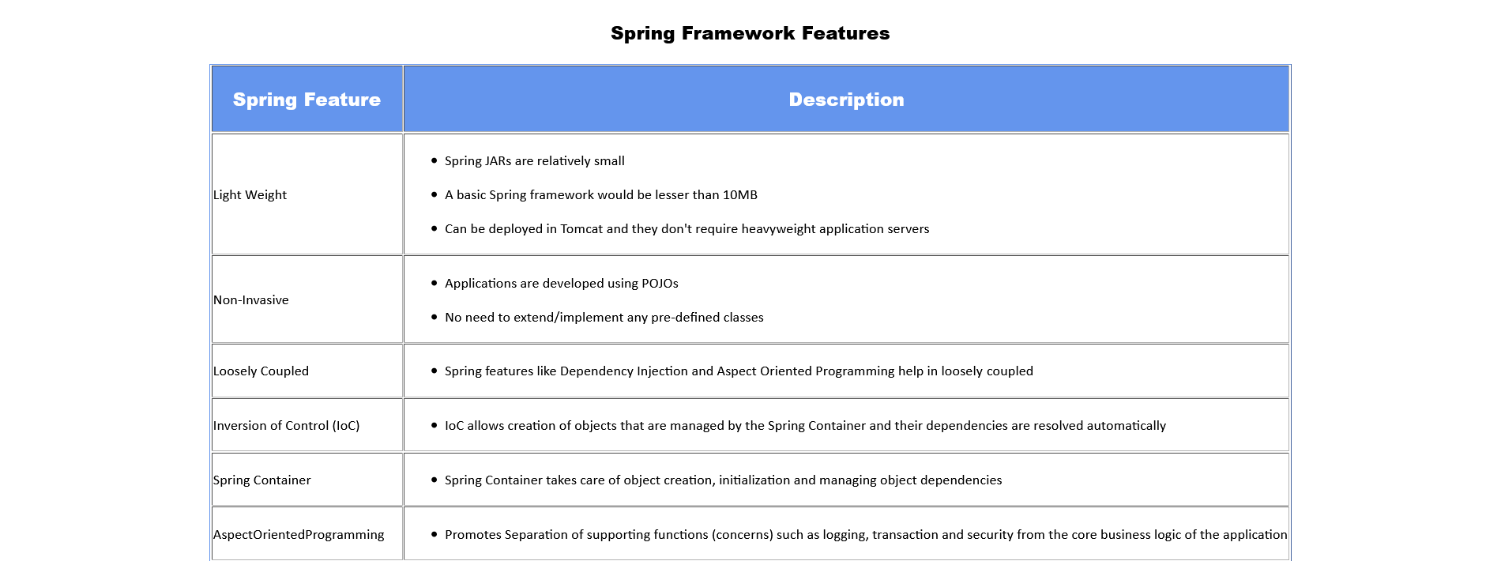

Slide 17
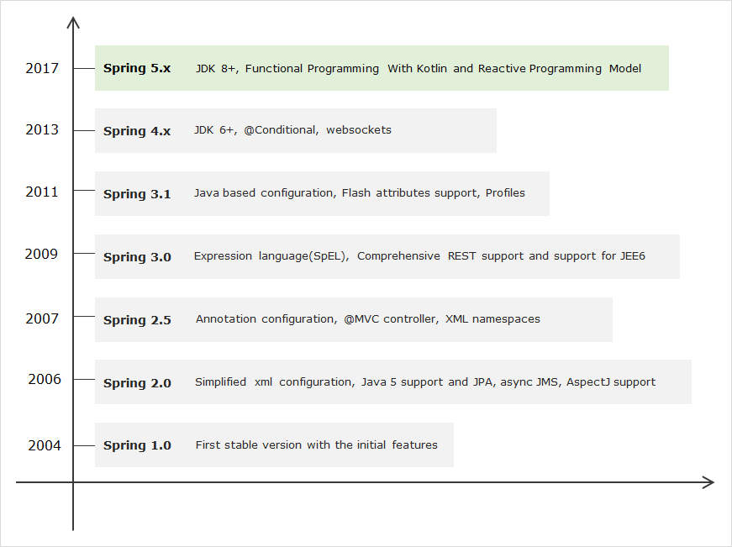
Over the last decade, the Spring Framework has grown dramatically. So, it is worthy to have a look at its evolution. The following image depicts the important features that have come along with each release of Spring, leading up to Spring Framework 5.0.

Slide 18
Current version of Spring Framework is 5.x. It has been enhanced with new features keeping core concepts same as Spring 4.x. At high level, the new features of Spring Framework 5.x are:
JDK baseline update
Core framework revision
Reactive Programming Model : Introduces a new non-blocking web framework called Spring WebFlux
Functional programming using Kotlin language support
Testing improvements by supporting integration with JUnit5
Let us look at Spring core relevant changes in detail:
JDK baseline update
The entire Spring framework 5.x code base runs on Java 8 and designed to work with Java 9. Therefore, Java 8 is the minimum requirement to work on Spring Framework 5.x.
Core framework revision
The core Spring Framework 5.x has been revised, one of the main change is that Spring comes with its own commons logging through spring-jcl jar instead of standard Commons Logging.
There are few more changes in Spring 5.x with respect to library support and discontinued support.

Slide 19
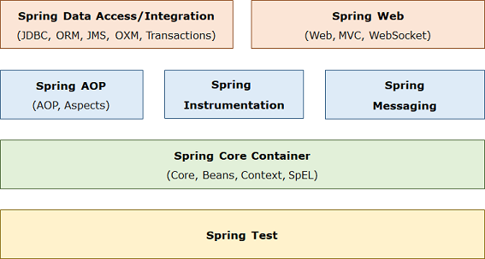
Spring is organized in a modular fashion. The developer can pick and choose the modules as per the need for building an enterprise application. Spring Framework 5.x has the following key module groups:
Spring Core Container: This module provides the Spring IoC container and Dependency Injection features.
Spring Data Access/Integration: This module provide support to access database in Spring applications.
Spring Web: This modules provide support to create web applications.
Spring AOP: This module supports aspect oriented programming implementation.
Spring Messaging: This module provides support for integrating Spring applications with messaging systems.
Spring Test: This module supports testing of Spring applications using JUnit or TestNG.

Slide 20
The Spring Core Container has the following modules:
Core: This is the key module of Spring Framework which provides fundamental support on which all other modules of the framework are dependent.
Bean: This module provide basic Spring IoC container called BeanFactory.
Context: This module provides Spring IoC container called ApplicationContext which extends the features of BeanFactory container and provides additional features for enterprise application development.
Spring Expression Language (SpEL): This module is used for querying/manipulating object value.

Slide 21
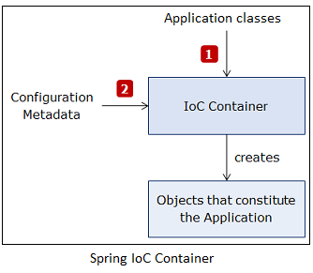
Introduction to Spring IoC Container
Spring framework provides a container for dependency injection. This container is called as Spring IoC container. It creates, initializes and injects the required objects. These objects whose life cycles are managed by Spring are called as Spring beans or beans. The Spring container needs information about objects of which class to create and how to wire them together. This information is called as configuration metadata. It can be provided in following ways:
XML configuration
Java-based configuration
Java Annotation-based configuration
Spring container reads the application classes using configuration metadata and then creates and wires beans in it as shown below:

Slide 22
The Spring IoC container is represented by the following interfaces:
BeanFactory interface: It represents container which provides basic functionalities. It instantiates bean whenever asked for by the client application. Using its getBean() method, you can get instances of beans. It instantiates bean objects only when getBean() method is called.
ApplicationContext interface: It extends BeanFactory interface and provides additional functionalities to support enterprise application development. It instantiates all beans when container is loaded. There are many implementations of this interface. Some commonly used implementation classes are as follows:
ClassPathXmlApplicationContext : It is used to process XML-based configuration metadata.
AnnotationConfigApplicationContext : It is used to process Java‐based configuration metadata.
Now, let us see how to configure Spring IoC container and use it.

Slide 23
Configuring and using Spring IoC Container
The Java-based configuration metadata is provided in Java class using following annotations:
@Configuration : The Java configuration class is marked with this annotation. This annotation identifies this as a configuration class, and it’s expected to contain details on beans that are to be created in the Spring application context.
@Bean : This annotation is used to declare a bean. The methods of configuration class that creates an instance of the desired bean are annotated with this annotation. These methods are called by Spring container during bootstrap and the values returned by these methods are treated as Spring beans. By default, only one bean instance is created for a bean definition by the Spring Container, and that instance is used by the container for the whole application lifetime.
For example, the CustomerLoginRepositoryImpl class can be configured in a Java class using the above annotations as follows :

Slide 24
@Configuration
public class SpringConfig {
@Bean
public CustomerLoginRepository customerLoginRepository() {
return new CustomerLoginRepositoryImpl();
}
}
By default, the bean name is same as the name of method in which bean is configured. So, in above code bean name is customerLoginRepository . If you want to change the bean name then you can either rename the method or provide a different name with the name attribute as follows:
@Bean(name="customerRepository")
public CustomerLoginRepository customerLoginRepository() {
return new CustomerLoginRepositoryImpl();
}

Slide 25
The CustomerLoginRepositoryImpl bean has no dependencies of its own but CustomerLoginServiceImpl class depends on CustomerRepository. So, you need to wire the dependencies in configuration class. The simplest way to do this is to refer the referenced bean’s method as follows:
@Bean
public CustomerLoginService customerLoginService() {
return new CustomerLoginServiceImpl(customerLoginRepository());
}
@Bean(name="customerRepository")
public CustomerLoginRepository customerLoginRepository() {
return new CustomerLoginRepositoryImpl();
}

Slide 26
So far, you have learnt that beans need to be configured in configuration class but in Java annotation-based configuration, there is no need to explicitly configure the bean. Spring automatically scans, detects and instantiates the beans from the specified package through component scanning. It looks for classes annotated with following annotations:
@Component : It is a general purpose annotation to mark a class as Spring bean.
​@Component
public class CustomerLoginController{
//rest of the code
}
@Service - It is used to define a service layer Spring bean. It is specialization of the @Component annotation for the service layer.
@Service
public class CustomerLoginSeviceImpl implements CustomerLoginService {
//rest of the code
}

Slide 27
@Repository - It is used to define a persistence layer Spring bean. It is specialization of the @Component annotation for the persistence layer.
​@Repository
public class CustomerLoginRepositoryImpl implements CustomerLoginRepository {
//rest of the code
}
@Controller - It is used to defined a web component. It is specialization of the @Component annotation for the presentation layer.
​@Controller
public class CustomerLoginController {
//rest of the code
}
By default, the bean name is same as class name with a lowercase initial character. Therefore, the above defined beans have the names customerLoginController, customerLoginServiceImpl and customerLoginRepositoryImpl. You can also give specific name to a bean with a value attribute of above annotations as follows:

Slide 28
​@Repository(value="customerLogin")
public class CustomerLoginRepositoryImpl implements CustomerLoginRepository {
//rest of the code
}
The component scanning isn’t enabled by default. You have to annotate configuration class with @ComponentScan annotation to enable component scanning as follows:
@Configuration
@ComponentScan
public class SpringConfig {
}
In the above code, Spring will scan the package that contains SpringConfig class and it sub-packages for beans. But if you want to scan a different package or multiple packages then you can specify this with the basePackages attribute as follows:

Slide 29
@Configuration
@ComponentScan(basePackages = "com.hnd.service com.hnd.repository")
public class SpringConfig {
}
In above code, the Spring will scan com.hnd.service and com.hnd.repository package and its sub-packages for beans.
If bean in your application are not having any dependencies, then component scanning alone works but if beans have dependencies, then you have to inject dependencies in your component-scanned beans. For this you have to do autowiring of dependencies.
You will learn this in the next module.

Slide 30
ApplicationContext can be loaded using AnnotationConfigApplicationContext class as follows:
ApplicationContext ctx = new AnnotationConfigApplicationContext(SpringConfig.class);
The getBean() method is used to access a particular bean by specifying its class as follows:
UserService userService = ctx.getBean(CustomerLoginServiceImpl.class);
The bean name which is the name of the method in which bean is configured can also be used to access a particular bean as follows:
UserService userService = (UserService) ctx.getBean("customerLoginServiceImpl");

Slide 31
Java-based configuration - Demo
Objective:
To understand how to define configuration metadata using Java-based configuration and use ApplicationContext.
Steps:
Step 1: Create a new Maven project using Eclipse.
Step 2: Add the following Spring dependency and properties in pom.xml:
<dependencies>
<dependency>
<groupId>org.springframework</groupId>
<artifactId>spring-context</artifactId>
<version>5.3.18</version>
</dependency>
</dependencies>
<properties>
<maven.compiler.target>17</maven.compiler.target>
<maven.compiler.source>17</maven.compiler.source>
</properties>

Slide 32
Step 3: Create the following Spring bean in com.hnd.bean package:
package com.hnd.bean;
public class WelcomeBean {
public String printWelcome() {
return "Welcome to Spring";
}
}
Step 4: Create the following configuration file in com.hnd.configuration package:
package com.hnd.configuration;
import org.springframework.context.annotation.Configuration;
import org.springframework.context.annotation.Bean;
import com.hnd.bean.WelcomeBean;
@Configuration
public class SpringConfig {
@Bean
public WelcomeBean welcomeBean() {
return new WelcomeBean();
}
}

Slide 33
Step 5: Create the following UserInterface class in com.hnd.ui package with the main method and instantiate the Spring container using configuration class you created in the previous step as the constructor argument. Retrieve the WelcomeBean via getBean() method and use it.
package com.hnd.ui;
import org.apache.commons.logging.Log;
import org.apache.commons.logging.LogFactory;
import org.springframework.context.ApplicationContext;
import org.springframework.context.annotation.AnnotationConfigApplicationContext;
import com.hnd.bean.WelcomeBean;
import com.hnd.configuration.SpringConfig;
public class UserInterface {
public static final Log LOGGER = LogFactory.getLog(UserInterface.class);
public static void main(String[] args) {
ApplicationContext applicationContext = new AnnotationConfigApplicationContext(SpringConfig.class);
WelcomeBean welcomeBean = applicationContext.getBean(WelcomeBean.class);
LOGGER.info(welcomeBean.printWelcome());
}
}

Slide 34

Step 6: Run the UserInterface class created in the previous step. You will get the following output:

Slide 35
Java-Annotation based configuration - Demo
Objective:
To understand how to define configuration metadata using Java-Annotation based configuration and use ApplicationContext
Steps:
Step 1: Create a new Maven project using Eclipse.
Step 2: Add the following Spring dependency in pom.xml:
<dependencies>
<dependency>
<groupId>org.springframework</groupId>
<artifactId>spring-context</artifactId>
<version>5.3.18</version>
</dependency>
</dependencies>
<properties>
<maven.compiler.target>17</maven.compiler.target>
<maven.compiler.source>17</maven.compiler.source>
</properties>

Slide 36
Step 3: Create the following Spring bean in com.hnd.bean package:
package com.hnd.bean;
import org.springframework.stereotype.Component;
@Component
public class WelcomeBean {
public String printWelcome() {
return "Welcome to Spring";
}
}
Step 4: Create the following configuration file in com.hnd.configuration package:
package com.hnd.configuration;
import org.springframework.context.annotation.ComponentScan;
import org.springframework.context.annotation.Configuration;
@Configuration
@ComponentScan(basePackages = "com.hnd.bean")
public class SpringConfig {
}

Slide 37
Step 5: Create the following UserInterface class in com.hnd.ui package with the main method and instantiate the Spring container using configuration class you created in the previous step as the constructor argument. Retrieve the WelcomeBean via getBean() method and use it.
package com.hnd.ui;
import org.apache.commons.logging.Log;
import org.apache.commons.logging.LogFactory;
import org.springframework.context.ApplicationContext;
import org.springframework.context.annotation.AnnotationConfigApplicationContext;
import com.hnd.bean.WelcomeBean;
import com.hnd.configuration.SpringConfig;
public class UserInterface {
public static final Log LOGGER = LogFactory.getLog(UserInterface.class);
public static void main(String[] args) {
ApplicationContext applicationContext = new AnnotationConfigApplicationContext(SpringConfig.class);
WelcomeBean welcomeBean = (WelcomeBean) applicationContext.getBean(WelcomeBean.class);
LOGGER.info(welcomeBean.printWelcome());
}
}

Slide 38

Step 6: Run the UserInterface class created in the previous step. You will get the following output:

Slide 39
Best Practices in Java-Annotation based Configuration
Some of the best practices that should be followed in Java-Annotation based configuration are:
Use specialized stereotypes and NOT generic stereotype
As you have seen previously, @Component is a 'generic' stereotype for any Spring-managed bean or component. We also derive @Service, @Repository and @Controller from @Component, which are 'specialized' stereotypes used for classes implementing Service, Persistence and Controller layers respectively.
@Component can be used interchangeably with any of the above derived specific stereotypes and there will not be any significant issue or complication to the application. However, it is a best practice to use the specific stereotypes for their respective layer implementations (which is @Service for Service Layer, @Repository for Persistence Layer and @Controller for Controller Layer).

Slide 40
Introduction to Autowiring
If one bean class is dependent on another bean class, then the bean dependencies need to be explicitly defined in your configuration class but you can let the Spring IoC container to inject the dependencies into dependent bean classes without defining in your configuration class. This is called as autowiring.
To do autowiring, you can use @Autowired annotation. This annotation allows Spring IoC container to resolve and inject dependencies into your bean. It can be applied to attributes, constructors, setter methods of a bean class.
Now, let us see how to use @Autowired annotation.

Slide 41
Using @Autowired annotation
You can use @Autowired annotation directly on properties. For example, in the following code, CustomerLoginRepository is injected in CustomerLoginServiceImpl class using @Autowired annotation:
public class CustomerLoginServiceImpl implements CustomerLoginService {
@Autowired
private CustomerLoginRepository customerLoginRepository;
public String authenticateCustomer(CustomerLoginDTO customerLogin) throws hndBankException {
try {
String toRet = null;
CustomerLoginDTO customerLoginFromDao = customerLoginRepository
.getCustomerLoginByLoginName(customerLogin.getLoginName());
if (customerLogin.getPassword().equals(customerLoginFromDao.getPassword())){
toRet = "SUCCESS";
}else{
throw new hndBankException("Service.WRONG_CREDENTIALS");
}
return toRet;
}catch(hndBankException exception) {
Log LOGGER = LogFactory.getLog(this.getClass());
LOGGER.error(exception.getMessage(),exception);
throw exception;
}
}
}

Slide 42
In above code, Spring container will perform dependency injection using the Java Reflection API. It will search for the class which implements CustomerLoginRepository interface and injects its object. The dependencies which are injected using @Autowired should be available to Spring container when the dependent bean object is created. If the container does not find a bean for autowiring, it will throw NoSuchBeanDefinitionException exception.
If more than one bean of the same type are available in the container, then the framework throws an exception indicating that more than one bean is available for autowiring. To handle this, @Qualifier annotation is used as follows:
public class CustomerLoginServiceImpl implements CustomerLoginService {
@Autowired
@Qualifier("jdbcRepository")
private CustomerLoginRepository customerLoginRepository;
}
In the above code snippet, if CustomerLoginRepository has multiple implementations then the implementation which is registered in container with name jdbcRepository will be injected.
Autowiring is done only for dependencies to other beans. It doesn't work for properties such as primitive data types, String, Enum, etc. For such properties, you can use the @Value annotation (not covered as part of this course).
Now, let us see how to use @Autowired annotation on setter methods.

Slide 43
The @Autowired annotation can also be used on setter methods. This is called as Setter Injection. For example, in the following code, CustomerLoginRepository is injected in CustomerLoginServiceImpl class using @Autowired annotation on the setter method:
public class CustomerLoginServiceImpl implements CustomerLoginService {
private CustomerLoginRepository customerLoginRepository;
@Autowired
public void setCustomerLoginRepository(CustomerLoginRepository customerLoginRepository) {
this.customerLoginRepository = customerLoginRepository;
}
public String authenticateCustomer(CustomerLoginDTO customerLogin) throws hndBankException {

Slide 44
try {
String toRet = null;
CustomerLoginDTO customerLoginFromDao = customerLoginRepository
.getCustomerLoginByLoginName(customerLogin.getLoginName());
if (customerLogin.getPassword().equals(customerLoginFromDao.getPassword())){
toRet = "SUCCESS";
}else{
throw new hndBankException("Service.WRONG_CREDENTIALS");
}
return toRet;
}catch(hndBankException exception) {
Log LOGGER = LogFactory.getLog(this.getClass());
LOGGER.error(exception.getMessage(),exception);
throw exception;
}
}
}
In above code snippet, the Spring IoC container will call setter method for injecting the dependency.

Slide 45
The @Autowired annotation can also be used on constructor. This is called as Constructor Injection. For example, in the following code, CustomerLoginRepository is injected in CustomerLoginServiceImpl class using @Autowired annotation on constructor:
public class CustomerLoginServiceImpl implements CustomerLoginService {
private CustomerLoginRepository customerLoginRepository;
@Autowired
public CustomerLoginServiceImpl(CustomerLoginRepository customerLoginRepository ) {
this.customerLoginRepository = customerLoginRepository ;
}
public String authenticateCustomer(CustomerLoginDTO customerLogin) throws hndBankException {

Slide 46
try {
String toRet = null;
CustomerLoginDTO customerLoginFromDao = customerLoginRepository
.getCustomerLoginByLoginName(customerLogin.getLoginName());
if (customerLogin.getPassword().equals(customerLoginFromDao.getPassword())){
toRet = "SUCCESS";
}else{
throw new hndBankException("Service.WRONG_CREDENTIALS");
}
return toRet;
}catch(hndBankException exception) {
Log LOGGER = LogFactory.getLog(this.getClass());
LOGGER.error(exception.getMessage(),exception);
throw exception;
}
}
}
In the above code snippet, the Spring IoC container will call constructor for injecting the dependency.

Slide 47
Autowiring - Demo
Objective:
To implement Customer Login user story using autowiring and Java annotation based configuration.
Steps:
Step 1: Create a new Maven project using Eclipse.
Step 2: Add the following Spring dependency and properties in pom.xml:
<dependencies>
<dependency>
<groupId>org.springframework</groupId>
<artifactId>spring-context</artifactId>
<version>5.3.18</version>
</dependency>
<dependency>
<groupId>org.apache.logging.log4j</groupId>
<artifactId>log4j-api</artifactId>
<version>2.17.1</version>
</dependency>

Slide 48
<dependency>
<groupId>org.apache.logging.log4j</groupId>
<artifactId>log4j-core</artifactId>
<version>2.17.1</version>
</dependency>
</dependencies>
<properties>
<maven.compiler.target>17</maven.compiler.target>
<maven.compiler.source>17</maven.compiler.source>
</properties>
Step 3: Create a package named com.hnd.dto, and then create the following Java class in it:
package com.hnd.dto;
public class CustomerLoginDTO {
private String loginName;
private String password;
public String getLoginName() {
return loginName;
}

Slide 49
public void setLoginName(String loginName) {
this.loginName = loginName;
}
public String getPassword() {
return password;
}
public void setPassword(String password) {
this.password = password;
}
@Override
public String toString() {
return "CustomerLoginDTO [loginName=" + loginName + ", password=" + password + "]";
}
}
Step 4: Create a package named com.hnd.repository, and then create the following interface in it:

Slide 50
package com.hnd.repository;
import com.hnd.dto.CustomerLoginDTO;
public interface CustomerLoginRepository {
public CustomerLoginDTO getCustomerLoginByLoginName(String loginName);
}
Step 5: Create the following class in com.hnd.repository package:
package com.hnd.repository;
import java.util.HashMap;
import java.util.Map;
import org.springframework.stereotype.Repository;
import com.hnd.dto.CustomerLoginDTO;
@Repository(value="customerLoginRepository")
public class CustomerLoginRepositoryImpl implements CustomerLoginRepository {
public CustomerLoginDTO getCustomerLoginByLoginName(String loginName) {
Map<String, String> customerCredentials = new HashMap<String, String>();
customerCredentials.put("robin", "robin123");
customerCredentials.put("harry", "harry123");
customerCredentials.put("garry", "garry123");
customerCredentials.put("monica", "mocica123");
CustomerLoginDTO customerLogin = new CustomerLoginDTO();
customerLogin.setLoginName(loginName);
customerLogin.setPassword(customerCredentials.get(loginName));
return customerLogin;
}
}

Slide 51
Step 6: Create a package named com.hnd.service and then create the following interface in it:
package com.hnd.service;
import com.hnd.dto.CustomerLoginDTO;
import com.hnd.exception.hndBankException;
public interface CustomerLoginService {
public String authenticateCustomer(CustomerLoginDTO customerLogin) throws hndBankException;
}
Step 7: Create the following class in com.hnd.service package:
package com.hnd.service;
import org.apache.commons.logging.Log;
import org.apache.commons.logging.LogFactory;
import org.springframework.beans.factory.annotation.Autowired;
import org.springframework.stereotype.Service;
import com.hnd.dto.CustomerLoginDTO;
import com.hnd.exception.hndBankException;
import com.hnd.repository.CustomerLoginRepository;

Slide 52
@Service(value="customerLoginService")
public class CustomerLoginServiceImpl implements CustomerLoginService {
@Autowired
private CustomerLoginRepository customerLoginRepository;
public String authenticateCustomer(CustomerLoginDTO customerLogin) throws hndBankException {
try {
String toRet = null;
CustomerLoginDTO customerLoginFromDao = customerLoginRepository
.getCustomerLoginByLoginName(customerLogin.getLoginName());
if (customerLogin.getPassword().equals(customerLoginFromDao.getPassword())){
toRet = "SUCCESS";
}else{
throw new hndBankException("Service.WRONG_CREDENTIALS");
}
return toRet;
}catch(hndBankException exception) {
Log LOGGER = LogFactory.getLog(this.getClass());
LOGGER.error(exception.getMessage(),exception);
throw exception;
}
}
}

Slide 53
Step 8: Create a package named com.hnd.controller and then create the following class in it:
package com.hnd.controller;
import org.springframework.beans.factory.annotation.Autowired;
import org.springframework.stereotype.Controller;
import com.hnd.dto.CustomerLoginDTO;
import com.hnd.exception.hndBankException;
import com.hnd.service.CustomerLoginService;
@Controller(value="customerLoginController")
public class CustomerLoginController {
@Autowired
private CustomerLoginService customerLoginService;
public String authenticateCustomer(CustomerLoginDTO customerLogin) throws hndBankException {
return customerLoginService.authenticateCustomer(customerLogin);
}
}

Slide 54
Step 9: Create a package named com.hnd.configuration and create following Java‐based bean configuration class in it:
package com.hnd.configuration;
import org.springframework.context.annotation.ComponentScan;
import org.springframework.context.annotation.Configuration;
import org.springframework.context.annotation.PropertySource;
@Configuration
@PropertySource("classpath:messages.properties")
@ComponentScan(basePackages="com.hnd.service com.hnd.repository com.hnd.controller")
public class SpringConfig {
}
Step 10: Create the following message.properties file in src/main/resources folder:
Service.WRONG_CREDENTIALS=Login denied. Invalid credentials.
SUCCESS=Customer logged in successfully!!

Slide 55
Step 11: Spring will configure log4j2 when the required dependency is added in pom.xml and also the log4j2.properties is added in src/main/resources.
Step 12: Create a package named com.hnd.ui and create the following UserInterface class with the main method in it:
package com.hnd.ui;
import org.apache.commons.logging.Log;
import org.apache.commons.logging.LogFactory;
import org.springframework.context.ApplicationContext;
import org.springframework.context.annotation.AnnotationConfigApplicationContext;
import org.springframework.core.env.Environment;
import com.hnd.configuration.SpringConfig;
import com.hnd.controller.CustomerLoginController;
import com.hnd.dto.CustomerLoginDTO;
import com.hnd.exception.hndBankException;

Slide 56
public class UserInterface {
public static final Log LOGGER = LogFactory.getLog(UserInterface.class);
public static void main(String[] args) throws Exception {
Environment environment=null;
ApplicationContext applicationContext =null;
try{
applicationContext = new AnnotationConfigApplicationContext(SpringConfig.class);
environment=applicationContext.getEnvironment();
CustomerLoginController customerLoginController = applicationContext
.getBean(CustomerLoginController.class);
CustomerLoginDTO customerLogin = new CustomerLoginDTO();
customerLogin.setLoginName("harry");
customerLogin.setPassword("harry123");
customerLoginController.authenticateCustomer(customerLogin);
LOGGER.info(environment.getProperty("SUCCESS"));
}catch(hndBankException exception){
LOGGER.error(environment.getProperty(exception.getMessage()));
}
}
}

Slide 57


Note: hndBankException class is already implented.
Step 13: Run the UserInterface class created in the previous step. You will get the following output:
For valid input, the output will be logged in console as:
For invalid input, the output will be logged in console as :

Slide 58
Best Practices in Spring Framework
A best practice that should be followed while developing with Spring Framework is:
Use only managed beans and avoid directly instantiating a class.
As you would have already noticed that we have not directly instantiated a class when it is used as a managed bean as instantiating it directly using the new is considered to be a bad practice.
@Controller(value="customerLoginController")
public class CustomerLoginController {
//This is a bad practice and should be avoided
private CustomerLoginService customerLoginService = new CustomerLoginServiceImpl();
public String authenticateCustomer(CustomerLoginDTO customerLogin) throws Exception {
String result = customerLoginService.authenticateCustomer(customerLogin);
return result;
}
}

Slide 59
What could be the reason for this?
When a class is used to instantiate a managed bean in Spring, it benefits from different features of the framework. For example, each bean in Spring is a component and it can take advantage of all services. Also, the bean is eligible for injection into other objects.
Hence, as a best practice, use only managed beans. Thus, the developers have to rely on injecting the bean.
@Controller(value="customerLoginController")
public class CustomerLoginController {
@Autowired
private CustomerLoginService customerLoginService;
public String authenticateCustomer(CustomerLoginDTO customerLogin) throws Exception {
String result = customerLoginService.authenticateCustomer(customerLogin);
return result;
}
}
Whenever different instances of the same class is needed, Spring bean can be scoped as prototype.

Slide 60
Introduction to SpringBoot
You have learnt that Spring is a lightweight framework for developing enterprise Java applications but using Spring for application development is challenging for developer because of the following reasons which reduces the productivity and increases the development time:
1. Configuration
You have seen that Spring application requires lot of configuration. This configuration also needs to be overridden for different environments like production, development, testing, etc. For example, the database used by testing team may be different from the one used by development team. So, we have to spend lot of time in writing configuration instead of writing application logic for solving the business problems.

Slide 61
2. Project Dependency Management
When you develop a Spring application, you have to search for all compatible dependencies for the Spring version that you are using and then manually configure them. If wrong version of dependencies is selected, then it will be an uphill task to solve this problem. Also, for every new feature added to the application, the appropriate dependency needs to be identified and added.
All these reduce the productivity.
It would be much more better if the productivity could be improved by using a better framework.
Such a framework is Spring Boot.
Spring Boot is a framework built on the top Spring framework that helps developers build Spring-based applications quickly and easily. The main goal of Spring Boot is to quickly create Spring-based applications without requiring developers to write the same boilerplate configuration again and again.
How does it work?
It works because of following reasons:

Slide 62
1. Spring Boot is opinionated framework
Spring Boot forms opinions. It means that Spring Boot has some sensible defaults which you can use to quickly build your application. For example, Spring Boot uses embedded Tomcat as the default web container.
2. Spring Boot is customizable
Though Spring Boot has its defaults, you can easily customize it at any time during your development based on your need. For example, if you prefer log4j for logging over Spring Boot built-in logging support, then you can easily make dependency change in your pom.xml file to replace the default logger with log4j dependencies.
The main features of Spring Boot are as follows:
Starter Dependencies
Automatic Configuration
Spring Boot Actuator
Embedded Servlet Container

Slide 63
Spring Boot comes with many starters. Spring Boot starters are pre-configured dependency descriptors with most commonly used libraries that you can add in your application. So, you don't need to search for compatible libraries and configure them manually. Spring Boot will ensure that the necessary libraries are added to the build. To use these starters, you have to add them in the pom.xml file. For example, to use spring-boot-starter, following dependency needs to be added in pom.xml:
<dependency>
<groupId>org.springframework.boot</groupId>
<artifactId>spring-boot-starter</artifactId>
</dependency>

Slide 64
Some popular starters which we are going to use in this course are as follows:
spring-boot-starter - This is the core starter which includes support for auto-configuration, logging and YAML.
spring-boot-starter-aop - This starter is used for aspect-oriented programming with Spring AOP and AspectJ.
spring-boot-starter-data-jdbc - This starter is used for Spring Data JDBC.
spring-boot-starter-data-jpa - This starter is used for Spring Data JPA with Hibernate.
spring-boot-starter-web - This starter is used for building web application using Spring MVC and Spring REST. It also provides Tomcat as the default embedded container.
spring-boot-starter-test - This starter provides support for testing Spring Boot applications using libraries such as JUnit, Hamcrest and Mockito.
spring-boot-starter-log4j2 - This starter provides support for using Log4j2 for logging. It is an alternative to spring-boot-starter-logging.
spring-boot-starter-actuator - This starter provides support for using Spring Boot Actuator.

Slide 65
Spring Boot uses auto-configuration to automatically configure application by providing the basic configuration required to run the application based on the jar dependencies available on the classpath. This eliminates the need of manually configuring Spring applications.
For example, if you are using JDBC in your Spring Boot application, then there is no need to configure any database connection beans. As soon as Spring Boot detects that you have JDBC library in application’s classpath, it will automatically configure database connection beans.
You will learn more about the auto configuration as you proceed in this course.

Slide 66
The Spring Boot Starter Parent defines key versions of dependencies and default plugins for quickly building Spring Boot applications. It is present in pom.xml file of application as a parent as follows:
<parent>
<groupId>org.springframework.boot</groupId>
<artifactId>spring-boot-starter-parent</artifactId>
<version>2.6.6</version>
<relativePath/>
</parent>
It allows you to manage the following things for multiple child projects and modules:
Configuration – The Java version and other properties
Dependencies – The version of dependencies
Default Plugins Configuration – This includes default configuration for Maven plugins such as maven-failsafe-plugin, maven-jar-plugin, maven-surefire-plugin, maven-war-plugin

Slide 67
There are multiple approaches for creating Spring Boot application. You can use any of the following approaches:
Using Spring Initializr
Using the Spring Tool Suite (STS)
Using Spring Boot CLI
Using Spring Maven Project
In this course, you will learn how to use Spring Initializr for creating Spring Boot applications.

Slide 68
Creating a Spring Boot application - Demo
Objective:
To understand how to create a spring Boot application
Steps:
Step 1: Launch Spring Initializr to create your Spring Boot application. You will get following screen:

Slide 69
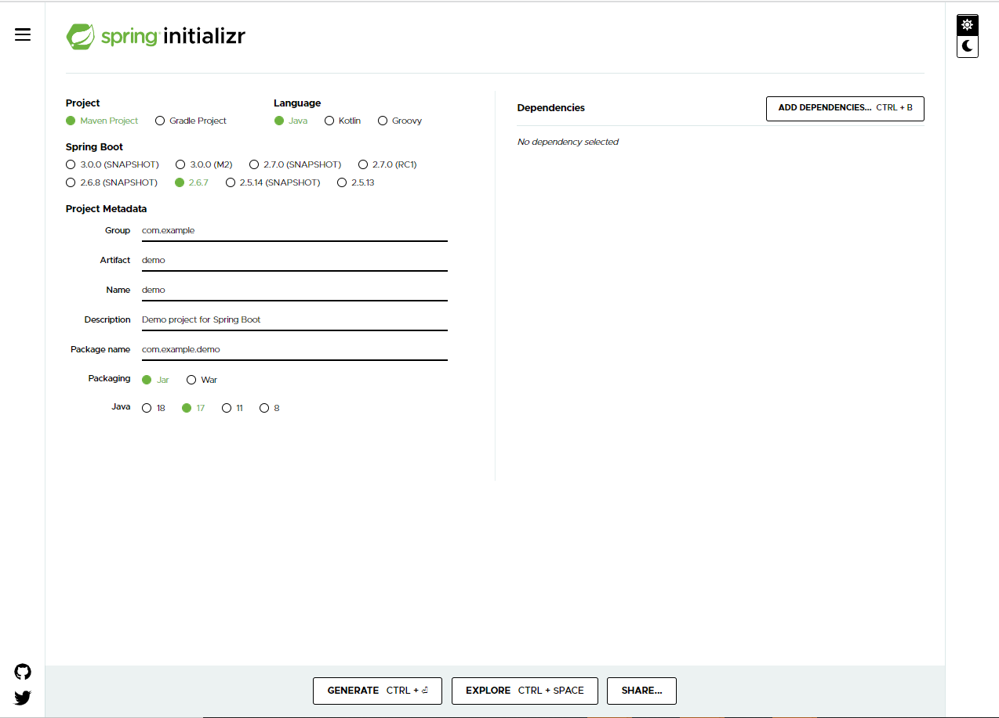

Slide 70
Step 2: Select Project as Maven Project, Language as Java, and Spring Boot as 2.6.7(We are using 2.6.6 in our demos) and enter the project details as follows:
Choose com.hnd as Group
Choose Demo_SpringBoot as Artifact
Choose Demo_SpringBoot as Name
Choose Demo project for Spring Boot as Description
Choose com.hnd as Package name
Choose Jar as Packaging
Choose 17 as Java version
You will get following screen:

Slide 71
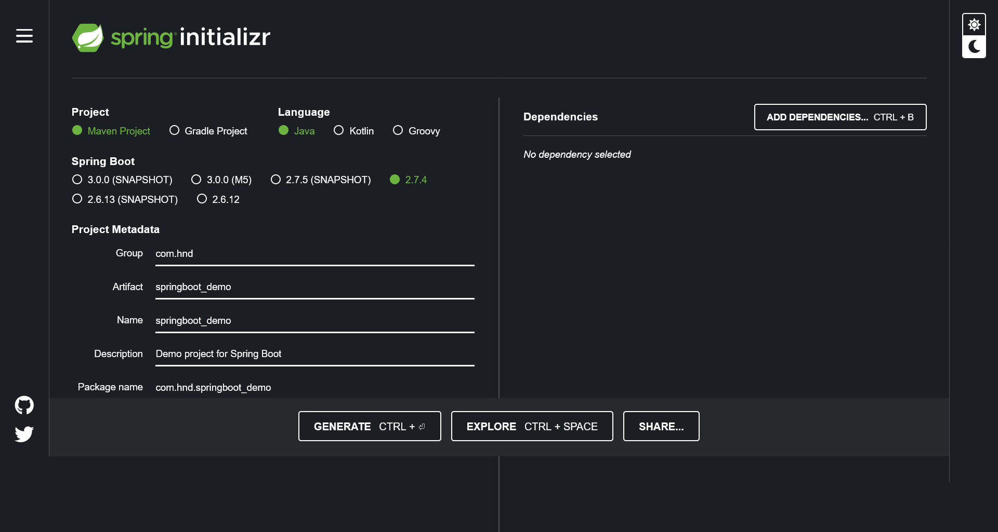

Slide 72
Step 4: Unzip the zip file and extract to a folder.
Step 5: In Eclipse, click File → Import → Existing Maven Project. Navigate or type in the path of the folder where you extracted the zip file to in the next screen.
Step 6: Execute the Spring Boot application by running the DemoSpringBootApplication as a standalone Java class. This class contains the main() method.

Slide 73
Understanding the structure of a Spring Boot project
The project generated in the previous demo contains the following files:
1. pom.xml
This file contains information about the project and configuration details used by Maven to build the project.
<?xml version="1.0" encoding="UTF-8"?>
<project xmlns="http://maven.apache.org/POM/4.0.0" xmlns:xsi="http://www.w3.org/2001/XMLSchema-instance"
xsi:schemaLocation="http://maven.apache.org/POM/4.0.0 https://maven.apache.org/xsd/maven-4.0.0.xsd">
<modelVersion>4.0.0</modelVersion>
<parent>
<groupId>org.springframework.boot</groupId>
<artifactId>spring-boot-starter-parent</artifactId>
<version>2.6.6</version>
<relativePath/> <!-- lookup parent from repository -->
</parent>
<groupId>com.hnd</groupId>
<artifactId>Demo_SpringBoot</artifactId>
<version>0.0.1-SNAPSHOT</version>
<name>Demo_SpringBoot</name>
<description>Demo project for Spring Boot</description>

Slide 74
<properties>
<java.version>17</java.version>
</properties>
<dependencies>
<dependency>
<groupId>org.springframework.boot</groupId>
<artifactId>spring-boot-starter</artifactId>
</dependency>
<dependency>
<groupId>org.springframework.boot</groupId>
<artifactId>spring-boot-starter-test</artifactId>
<scope>test</scope>
<exclusions>
<exclusion>
<groupId>org.junit.vintage</groupId>
<artifactId>junit-vintage-engine</artifactId>
</exclusion>
</exclusions>
</dependency>
</dependencies>
<build>

Slide 75
<plugins>
<plugin>
<groupId>org.springframework.boot</groupId>
<artifactId>spring-boot-maven-plugin</artifactId>
</plugin>
</plugins>
</build>
</project>
2. application.properties
This file contains application-wide properties. Spring reads the properties defined in this file to configure your application. You can define a server’s default port, server’s context path, database URLs, etc. in this file.
3. DemoSpringBootApplication.java
This class is by default generated by Spring Boot to bootstrap Spring application:

Slide 76
package com.hnd;
import org.springframework.boot.SpringApplication;
import org.springframework.boot.autoconfigure.SpringBootApplication;
@SpringBootApplication
public class DemoSpringBootApplication {
public static void main(String[] args) {
SpringApplication.run(DemoSpringBootApplication.class, args);
}
}
It is annotated with @SpringBootApplication annotation which triggers auto-configuration and component scanning and can be used to declare one or more @Bean methods also. It contains the main method which bootstraps the application by calling the run() method on SpringApplication class. The run() method accepts DemoSpringBootApplication.class as parameter to tell Spring Boot that this is the primary component.
4. DemoSpringBootApplicationTests.java
In this file, test cases are written.

Slide 77
@SpringBootApplication
We have already seen that the class which is used to bootstrap Spring Boot application is annotated with @SpringBootApplication annotation as follows:
package com.hnd;
import org.springframework.boot.SpringApplication;
import org.springframework.boot.autoconfigure.SpringBootApplication;
@SpringBootApplication
public class DemoSpringBootApplication {
public static void main(String[] args) {
SpringApplication.run(DemoSpringBootApplication.class, args);
}
}
Now, let us understand this annotation in detail.

Slide 78
The @SpringBootApplication annotation indicates that it is a configuration class and also triggers auto-configuration and component scanning. It is a combination of the following annotations with their default attributes:
@EnableAutoConfiguration – This annotation enables auto-configuration for Spring Boot application which automatically configures your application based on the dependencies that you have added.
@ComponentScan – This enables Spring bean dependency injection feature by using @Autowired annotation. All application components which are annotated with @Component, @Service, @Repository or @Controller are automatically registered as Spring Beans. These beans can be injected by using @Autowired annotation.
@Configuration – This enables Java based configurations for Spring boot application.

Slide 79
Spring Boot Runners
So far, you have learnt how to create and start Spring Boot application. If you want to perform some action immediately after the application has started, then for this Spring Boot provides following two interfaces:
CommandLineRunner
ApplicationRunner
CommandLineRunner is a Spring Boot interface with a run() method. Spring Boot automatically calls this method of all beans implementing this interface after the application context has been loaded.
To use this interface, you can modify the DemoSpringBootApplication class created in the previous demo as follows:

Slide 80
package com.hnd;
import org.apache.commons.logging.Log;
import org.apache.commons.logging.LogFactory;
import org.springframework.boot.CommandLineRunner;
import org.springframework.boot.SpringApplication;
import org.springframework.boot.autoconfigure.SpringBootApplication;
@SpringBootApplication
public class DemoSpringBootApplication implements CommandLineRunner {
public static final Log LOGGER = LogFactory.getLog(DemoSpringBootApplication.class);
public static void main(String[] args) {
SpringApplication.run(DemoSpringBootApplication.class, args);
}
@Override
public void run(String... args) throws Exception {
LOGGER.info("Welcome to CommandLineRunner");
}
}

Slide 81
Configuring Spring Boot application
Spring Boot application is configured using a file named application.properties. It is auto detected without any Spring based configuration and is placed inside "src/main/resources“.
In this file, various default properties are specified to support logging, aspect-oriented programming, etc. All the default properties need not be specified in all the cases. We can specify them only on-demand. At startup, Spring application loads all the properties and adds them to the Spring Environment class. To use a custom property, the property needs to be added to the application.properties file. Then, the Environment class should be autowired into a class where the property is required and the property should be read from Environment using getProperty() method.

Slide 82
Spring Boot - Demo
To understand how to implement Customer Login user story using Spring Boot.
Steps:
Step 1: Create a new Spring Boot project using Spring Initializr
Step 2: Create the following class in com.hnd.dto package:

Slide 83
package com.hnd.dto;
public class CustomerLoginDTO {
private String loginName;
private String password;
public String getLoginName() {
return loginName;
}
public void setLoginName(String loginName) {
this.loginName = loginName;
}
public String getPassword() {
return password;
}
public void setPassword(String password) {
this.password = password;
}
@Override
public String toString() {
return "CustomerLoginDTO [loginName=" + loginName + ", password=" + password + "]";
}
}

Slide 84
Step 3: Create the following interface in com.hnd.repository package:
package com.hnd.repository;
import com.hnd.dto.CustomerLoginDTO;
public interface CustomerLoginRepository {
public CustomerLoginDTO getCustomerLoginByLoginName(String loginName);
}
Step 4: Create the following class in com.hnd.repository package:
package com.hnd.repository;
import java.util.HashMap;
import java.util.Map;
import org.springframework.stereotype.Repository;
import com.hnd.dto.CustomerLoginDTO;
@Repository(value="customerLoginRepository")
public class CustomerLoginRepositoryImpl implements CustomerLoginRepository {

Slide 85
public CustomerLoginDTO getCustomerLoginByLoginName(String loginName) {
Map<String, String> customerCredentials = new HashMap<String, String>();
customerCredentials.put("robin", "robin123");
customerCredentials.put("harry", "harry123");
customerCredentials.put("garry", "garry123");
customerCredentials.put("monica", "monica123");
CustomerLoginDTO customerLogin = new CustomerLoginDTO();
customerLogin.setLoginName(loginName);
customerLogin.setPassword(customerCredentials.get(loginName));
return customerLogin;
}
}
Step 5: Create the following interface in com.hnd.service package:
package com.hnd.service;
import com.hnd.dto.CustomerLoginDTO;
public interface CustomerLoginService {
public String authenticateCustomer(CustomerLoginDTO customerLogin) throws hndBankException;
}

Slide 86
Step 6: Create the following class in com.hnd.service package
package com.hnd.service;
import org.springframework.beans.factory.annotation.Autowired;
import org.springframework.stereotype.Service;
import com.hnd.dto.CustomerLoginDTO;
import com.hnd.exception.hndBankException;
import com.hnd.repository.CustomerLoginRepository;
@Service(value="customerLoginService")
public class CustomerLoginServiceImpl implements CustomerLoginService {
@Autowired
private CustomerLoginRepository customerLoginRepository;
public String authenticateCustomer(CustomerLoginDTO customerLogin) throws hndBankException {
String toRet = null;
CustomerLoginDTO customerLoginFromRepository = customerLoginRepository
.getCustomerLoginByLoginName(customerLogin.getLoginName());
if (customerLogin.getPassword().equals(customerLoginFromRepository.getPassword())){
toRet = "SUCCESS";
}else{
throw new hndBankException("Service.WRONG_CREDENTIALS");
}
return toRet;
}
}

Slide 87
Step 7: Create the following CustomerLoginController class in com.hnd.controller package as follows:
package com.hnd.controller;
import org.springframework.beans.factory.annotation.Autowired;
import org.springframework.stereotype.Controller;
import com.hnd.dto.CustomerLoginDTO;
import com.hnd.exception.hndBankException;
import com.hnd.service.CustomerLoginService;
@Controller(value="customerLoginController")
public class CustomerLoginController {
@Autowired
private CustomerLoginService customerLoginService;
public String authenticateCustomer(CustomerLoginDTO customerLogin) throws hndBankException {
String b = customerLoginService.authenticateCustomer(customerLogin);
return b;
}
}

Slide 88
Step 8: Add the following properties to application.properties file:
Service.WRONG_CREDENTIALS=Login denied. Invalid credentials.
SUCCESS=Customer logged in successfully!!
Step 9: Modify the DemoSpringBootCoreApplication class in com.hnd package as follows:
package com.hnd;
import org.apache.commons.logging.Log;
import org.apache.commons.logging.LogFactory;
import org.springframework.beans.factory.annotation.Autowired;
import org.springframework.boot.CommandLineRunner;
import org.springframework.boot.SpringApplication;
import org.springframework.boot.autoconfigure.SpringBootApplication;
import org.springframework.core.env.Environment;
import com.hnd.controller.CustomerLoginController;
import com.hnd.dto.CustomerLoginDTO;
import com.hnd.exception.hndBankException;

Slide 89
@SpringBootApplication
public class DemoSpringBootCoreApplication implements CommandLineRunner {
public static final Log LOGGER = LogFactory.getLog(DemoSpringBootCoreApplication.class);
@Autowired
CustomerLoginController customerLoginController;
@Autowired
Environment environment;
public static void main(String[] args) {
SpringApplication.run(DemoSpringBootCoreApplication.class, args);
}
@Override
public void run(String... args) throws Exception {
try{
CustomerLoginDTO customerLogin = new CustomerLoginDTO();
customerLogin.setLoginName("harry");
customerLogin.setPassword("harry123");
customerLoginController.authenticateCustomer(customerLogin);
LOGGER.info(environment.getProperty("SUCCESS"));
}catch(hndBankException exception){
LOGGER.error(environment.getProperty(exception.getMessage()));
}
}
}

Slide 90
Note: hndBankException class is already implented.
Step 10 : Run the DemoSpringBootCoreApplication class created in the previous step.

Slide 91
Logging in Spring Boot using default logger
While executing your Spring Boot application, have you seen messages like the ones given below getting printed on your console?
2020-Jul-19 21:08:09 PM [main] INFO c.i.DemoSpringBootLoggingApplication - Starting DemoSpringBootLoggingApplication on MYSHEC259179L with PID 12008 (D:\FA2_Content_Work\Logging\Demo_SpringBoot_Logging\target\classes started by sweekruti.das in D:\FA2_Content_Work\Logging\Demo_SpringBoot_Logging)
2020-Jul-19 21:08:09 PM [main] INFO c.i.DemoSpringBootLoggingApplication - No active profile set, falling back to default profiles: default
2020-Jul-19 21:08:10 PM [main] INFO c.i.DemoSpringBootLoggingApplication - Started DemoSpringBootLoggingApplication in 1.493 seconds (JVM running for 2.121)
Any guess what are these?
These are messages logged at INFO level but, you haven't written any code for logging in your application. Then who does this?
This is done by Spring Boot.
Spring Boot uses Apache Commons Logging for logging. It provides default configurations for using Java Util Logging, Log4j2, and Logback as logging implementation. If Spring Boot starters are used then Logback is used for logging by default.
By default, it logs messages in console at ERROR, WARN, and INFO levels. You can easily configure logging levels, logging format, and log file location by setting logging related properties in application.properties file.

Slide 92
Configuring Logging Levels
Spring Boot by default, logs messages at ERROR, WARN, and INFO levels. You can also set the logging levels in application.properties file by setting the property logging.level.<logger-name>=<logging-level> where logging-level is one of TRACE, DEBUG, INFO, WARN, ERROR, FATAL, or OFF. For example, you can set the logging level as INFO for classes in com.hnd package as follows :
logging.level.com.hnd = INFO
The root logger can be configured by setting logging.level.root property in application.properties file.
Configuring Logging Pattern
You can change the logging pattern for console by setting logging.pattern.console property in application.properties file as follows:
# Logging pattern for the console
logging.pattern.console = %d{yyyy-MMM-dd HH:mm:ss a} [%t] %-5level %logger{36} - %msg%n

Slide 93
To change the logging pattern for file, set the logging.pattern.file property in application.properties file as follows:
# Logging pattern for file
logging.pattern.file = %d{yyyy-MM-dd HH:mm:ss} [%thread] %-5level %logger{36} - %msg%n
Configuring Logging File
By default, Spring Boot logs only to the console and does not log to files. If you want to log messages in files in addition to the console, you need to set logging.file property in application.properties file. The value for this property can be exact location of file or relative to the current directory. For example, to log messages in error.log file you can set logging.file.name property as follows:
logging.file.name = Error.log
You can also set the location of the log file by setting logging.file.path property in application.properties file.

Slide 94
logging.file.path=logs/Error.log
To have more more control over logging, you can use the logging provider specific configuration file in their default locations, which Spring Boot will automatically use. For example, if you are using Log4j, then log4j2.properties is used.
You will now see a demonstration of logging and then, you will learn how to use Log4j in a Spring Boot application

Slide 95
Logging in Spring Boot using default logger - Demo
Objective:
To understand how to implement Customer Login user story using default logger logging in Spring Boot.
Steps:
Step 1: Create a new Spring Boot project using Spring Initializr
Step 2: Create the following class in com.hnd.dto package:

Slide 96
package com.hnd.dto;
public class CustomerLoginDTO {
private String loginName;
private String password;
public String getLoginName() {
return loginName;
}
public void setLoginName(String loginName) {
this.loginName = loginName;
}
public String getPassword() {
return password;
}
public void setPassword(String password) {
this.password = password;
}
@Override
public String toString() {
return "CustomerLoginDTO [loginName=" + loginName + ", password=" + password + "]";
}
}

Slide 97
Step 3: Create the following interface in com.hnd.repository package:
package com.hnd.repository;
import com.hnd.dto.CustomerLoginDTO;
public interface CustomerLoginRepository {
public CustomerLoginDTO getCustomerLoginByLoginName(String loginName);
}
Step 4: Create the following class in com.hnd.repository package:
package com.hnd.repository;
import java.util.HashMap;
import java.util.Map;
import org.springframework.stereotype.Repository;
import com.hnd.dto.CustomerLoginDTO;
@Repository(value="customerLoginRepository")
public class CustomerLoginRepositoryImpl implements CustomerLoginRepository {

Slide 98
public CustomerLoginDTO getCustomerLoginByLoginName(String loginName) {
Map<String, String> customerCredentials = new HashMap<String, String>();
customerCredentials.put("robin", "robin123");
customerCredentials.put("harry", "harry123");
customerCredentials.put("garry", "garry123");
customerCredentials.put("monica", "monica123");
CustomerLoginDTO customerLogin = new CustomerLoginDTO();
customerLogin.setLoginName(loginName);
customerLogin.setPassword(customerCredentials.get(loginName));
return customerLogin;
}
}
Step 5: Create the following interface in com.hnd.service package:
package com.hnd.service;
import com.hnd.dto.CustomerLoginDTO;
public interface CustomerLoginService {
public String authenticateCustomer(CustomerLoginDTO customerLogin) throws hndBankException;
}

Slide 99
Step 6: Create the following class in com.hnd.service package
package com.hnd.service;
import org.springframework.beans.factory.annotation.Autowired;
import org.springframework.stereotype.Service;
import com.hnd.dto.CustomerLoginDTO;
import com.hnd.exception.hndBankException;
import com.hnd.repository.CustomerLoginRepository;
@Service(value="customerLoginService")
public class CustomerLoginServiceImpl implements CustomerLoginService {
@Autowired
private CustomerLoginRepository customerLoginRepository;
public String authenticateCustomer(CustomerLoginDTO customerLogin) throws hndBankException {
String toRet = null;
CustomerLoginDTO customerLoginFromRepository = customerLoginRepository
.getCustomerLoginByLoginName(customerLogin.getLoginName());
if (customerLogin.getPassword().equals(customerLoginFromRepository.getPassword())){
toRet = "SUCCESS";
}else{
throw new hndBankException("Service.WRONG_CREDENTIALS");
}
return toRet;
}
}

Slide 100
Step 7: Create the following CustomerLoginController class in com.hnd.controller package as follows:
package com.hnd.controller;
import org.springframework.beans.factory.annotation.Autowired;
import org.springframework.stereotype.Controller;
import com.hnd.dto.CustomerLoginDTO;
import com.hnd.exception.hndBankException;
import com.hnd.service.CustomerLoginService;
@Controller(value="customerLoginController")
public class CustomerLoginController {
@Autowired
private CustomerLoginService customerLoginService;
public String authenticateCustomer(CustomerLoginDTO customerLogin) throws hndBankException {
String b = customerLoginService.authenticateCustomer(customerLogin);
return b;
}
}

Slide 101
Step 8 : Add the following properties to application.properties file:
Service.WRONG_CREDENTIALS=Login denied. Invalid credentials.
SUCCESS=Customer logged in successfully!!
# Logging Level
logging.level.com.hnd.service=ERROR
logging.level.com.hnd=INFO
# Logging pattern for the console
logging.pattern.console=%d{yyyy-MMM-dd HH:mm:ss a} [%t] %-5level %logger{36} - %msg%n
# Logging pattern for file
logging.pattern.file=%d{yyyy-MM-dd HH:mm:ss} [%thread] %-5level %logger{36} - %msg%n
# Logging File
logging.file.name=logs/Error.log
#logging.file.path=logs/Error.log
Step 9 : Modify the DemoSpringBootLoggingApplication class in com.hnd package as follows:

Slide 102
package com.hnd;
import org.apache.commons.logging.Log;
import org.apache.commons.logging.LogFactory;
import org.springframework.beans.factory.annotation.Autowired;
import org.springframework.boot.CommandLineRunner;
import org.springframework.boot.SpringApplication;
import org.springframework.boot.autoconfigure.SpringBootApplication;
import org.springframework.core.env.Environment;
import com.hnd.controller.CustomerLoginController;
import com.hnd.dto.CustomerLoginDTO;
import com.hnd.exception.hndBankException;
@SpringBootApplication
public class DemoSpringBootLoggingApplication implements CommandLineRunner {
private static final Log LOGGER = LogFactory.getLog(DemoSpringBootLoggingApplication.class);
@Autowired
CustomerLoginController customerLoginController;
@Autowired
Environment environment;

Slide 103
public static void main(String[] args) {
SpringApplication.run(DemoSpringBootLoggingApplication.class, args);
}
@Override
public void run(String... args) throws Exception {
// TODO Auto-generated method stub
try{
CustomerLoginDTO customerLogin = new CustomerLoginDTO();
customerLogin.setLoginName("harry");
customerLogin.setPassword("harry123");
customerLoginController.authenticateCustomer(customerLogin);
LOGGER.info(environment.getProperty("SUCCESS"));
}catch(hndBankException exception){
LOGGER.error(environment.getProperty(exception.getMessage()));
}
}
}

Slide 104
Step 10 : Run the DemoSpringBootLoggingApplication class created in the previous step.
Logging in Spring Boot using Log4j
Spring Boot, by default, uses Logback for logging. To use Log4j, you have to exclude spring-boot-starter-logging starter and include spring-boot-starter-log4j2 starter in pom.xml file as follows:
<!-- Exclude Spring Boot's Default Logging -->
<dependency>
<groupId>org.springframework.boot</groupId>
<artifactId>spring-boot-starter</artifactId>
<exclusions>
<exclusion>
<groupId>org.springframework.boot</groupId>
<artifactId>spring-boot-starter-logging</artifactId>
</exclusion>
</exclusions>
</dependency>
<!-- Add Log4j2 Dependency -->
<dependency>
<groupId>org.springframework.boot</groupId>
<artifactId>spring-boot-starter-log4j2</artifactId>
</dependency>

Slide 105
Log4J will help in logging information to different destinations that can be file, console, database etc.
Log4J can be configured in different ways. Here it will be done using properties file. Add log4j2.properties file to the root classpath of application, which Spring Boot will automatically use for logging.
Working with log4j Logger
Once configuration is done you can use the Log4J logger in the application. To log information, you first need to get a logger object. This logger object is obtained by invoking getLog() method of the org.apache.commons.logging.LogFactory class. This method takes the details of the class in which you want to log as a parameter and gives an object of org.apache.commons.logging.Log interface.
For example, if we want to log in a class, DemoSpringBootLog4jApplication, the code will be:

Slide 106
package com.hnd;
import org.apache.commons.logging.Log;
import org.apache.commons.logging.LogFactory;
import org.springframework.beans.factory.annotation.Autowired;
import org.springframework.boot.CommandLineRunner;
import org.springframework.boot.SpringApplication;
import org.springframework.boot.autoconfigure.SpringBootApplication;
import org.springframework.core.env.Environment;
import com.hnd.controller.CustomerLoginController;
import com.hnd.dto.CustomerLoginDTO;
import com.hnd.exception.hndBankException;
@SpringBootApplication
public class DemoSpringBootLog4jApplication implements CommandLineRunner{
private static final Log LOGGER = LogFactory.getLog(DemoSpringBootLog4jApplication.class);
@Autowired
CustomerLoginController customerLoginController;
@Autowired
Environment environment;
public static void main(String[] args) {
SpringApplication.run(DemoSpringBootLog4jApplication.class, args);
}
@Override
public void run(String... args) throws Exception {
try{
CustomerLoginDTO customerLogin = new CustomerLoginDTO();
customerLogin.setLoginName("harry");
customerLogin.setPassword("harry123");
customerLoginController.authenticateCustomer(customerLogin);
LOGGER.info(environment.getProperty("SUCCESS"));
}catch(hndBankException exception){
LOGGER.error(environment.getProperty(exception.getMessage()));
}
}
}

Slide 107
Logging in Spring Boot using Log4j - Demo
Objective:
To understand how to implement Customer Login user story using Log4j Logging in Spring Boot.
Steps:
Step 1: Create a new Spring Boot project using Spring Initializr
Step 2: Create the following class in com.hnd.dto package:

Slide 108
package com.hnd.dto;
public class CustomerLoginDTO {
private String loginName;
private String password;
public String getLoginName() {
return loginName;
}
public void setLoginName(String loginName) {
this.loginName = loginName;
}
public String getPassword() {
return password;
}
public void setPassword(String password) {
this.password = password;
}
@Override
public String toString() {
return "CustomerLoginDTO [loginName=" + loginName + ", password=" + password + "]";
}
}

Slide 109
Step 3: Create the following interface in com.hnd.repository package:
package com.hnd.repository;
import com.hnd.dto.CustomerLoginDTO;
public interface CustomerLoginRepository {
public CustomerLoginDTO getCustomerLoginByLoginName(String loginName);
}
Step 4: Create the following class in com.hnd.repository package:
package com.hnd.repository;
import java.util.HashMap;
import java.util.Map;
import org.springframework.stereotype.Repository;
import com.hnd.dto.CustomerLoginDTO;
@Repository(value="customerLoginRepository")
public class CustomerLoginRepositoryImpl implements CustomerLoginRepository {

Slide 110
public CustomerLoginDTO getCustomerLoginByLoginName(String loginName) {
Map<String, String> customerCredentials = new HashMap<String, String>();
customerCredentials.put("robin", "robin123");
customerCredentials.put("harry", "harry123");
customerCredentials.put("garry", "garry123");
customerCredentials.put("monica", "monica123");
CustomerLoginDTO customerLogin = new CustomerLoginDTO();
customerLogin.setLoginName(loginName);
customerLogin.setPassword(customerCredentials.get(loginName));
return customerLogin;
}
}
Step 5: Create the following interface in com.hnd.service package:
package com.hnd.service;
import com.hnd.dto.CustomerLoginDTO;
public interface CustomerLoginService {
public String authenticateCustomer(CustomerLoginDTO customerLogin) throws hndBankException;
}

Slide 111
Step 6: Create the following class in com.hnd.service package
package com.hnd.service;
import org.springframework.beans.factory.annotation.Autowired;
import org.springframework.stereotype.Service;
import com.hnd.dto.CustomerLoginDTO;
import com.hnd.exception.hndBankException;
import com.hnd.repository.CustomerLoginRepository;
@Service(value="customerLoginService")
public class CustomerLoginServiceImpl implements CustomerLoginService {
@Autowired
private CustomerLoginRepository customerLoginRepository;
public String authenticateCustomer(CustomerLoginDTO customerLogin) throws hndBankException {
String toRet = null;
CustomerLoginDTO customerLoginFromRepository = customerLoginRepository
.getCustomerLoginByLoginName(customerLogin.getLoginName());
if (customerLogin.getPassword().equals(customerLoginFromRepository.getPassword())){
toRet = "SUCCESS";
}else{
throw new hndBankException("Service.WRONG_CREDENTIALS");
}
return toRet;
}
}

Slide 112
Step 7: Create the following CustomerLoginController class in com.hnd.controller package as follows:
package com.hnd.controller;
import org.springframework.beans.factory.annotation.Autowired;
import org.springframework.stereotype.Controller;
import com.hnd.dto.CustomerLoginDTO;
import com.hnd.exception.hndBankException;
import com.hnd.service.CustomerLoginService;
@Controller(value="customerLoginController")
public class CustomerLoginController {
@Autowired
private CustomerLoginService customerLoginService;
public String authenticateCustomer(CustomerLoginDTO customerLogin) throws hndBankException {
String b = customerLoginService.authenticateCustomer(customerLogin);
return b;
}
}

Slide 113
Step 8 : Add the following properties to application.properties file:
Service.WRONG_CREDENTIALS=Login denied. Invalid credentials.
SUCCESS=Customer logged in successfully!!
Step 9 : Create log4j2.properties file in src/main/resources. Add the following properties to log4j2.properties file:
#Name of the Properties file
name=LoggerConfigFile
#Declaring logger for business logic
logger.file.name=com.hnd.service
logger.file.level=DEBUG
logger.file.appenderRef.file.ref=LoggerAppender
logger.file.additivity=false
#Declaring logger for business console
logger.console.name=com.hnd
logger.console.level=INFO
logger.console.appenderRef.file.ref=ConsoleAppender
logger.console.additivity=false

Slide 114
# File Appender
appender.file.name=LoggerAppender
appender.file.type=File
appender.file.fileName=log/ErrorLog.log
#Logging Pattern
appender.file.layout.type=PatternLayout
appender.file.layout.pattern=%d{dd-MMM-yyyy HH:mm:ss} %level - %m%n
# Console Appender
appender.console.name=ConsoleAppender
appender.console.type=Console
#Logging Pattern for console
appender.console.layout.type=PatternLayout
appender.console.layout.pattern=%m%n
Step 10 : Modify the DemoSpringBootLog4jApplication class in com.hnd package as follows:

Slide 115
package com.hnd;
import org.apache.commons.logging.Log;
import org.apache.commons.logging.LogFactory;
import org.springframework.beans.factory.annotation.Autowired;
import org.springframework.boot.CommandLineRunner;
import org.springframework.boot.SpringApplication;
import org.springframework.boot.autoconfigure.SpringBootApplication;
import org.springframework.core.env.Environment;
import com.hnd.controller.CustomerLoginController;
import com.hnd.dto.CustomerLoginDTO;
import com.hnd.exception.hndBankException;
@SpringBootApplication
public class DemoSpringBootLog4jApplication implements CommandLineRunner{
private static final Log LOGGER = LogFactory.getLog(DemoSpringBootLog4jApplication.class);
@Autowired
CustomerLoginController customerLoginController;
@Autowired
Environment environment;

Slide 116
public static void main(String[] args) {
SpringApplication.run(DemoSpringBootLog4jApplication.class, args);
}
@Override
public void run(String... args) throws Exception {
// TODO Auto-generated method stub
try{
CustomerLoginDTO customerLogin = new CustomerLoginDTO();
customerLogin.setLoginName("harry");
customerLogin.setPassword("harry123");
customerLoginController.authenticateCustomer(customerLogin);
LOGGER.info(environment.getProperty("SUCCESS"));
}catch(hndBankException exception){
LOGGER.error(environment.getProperty(exception.getMessage()));
}
}
}

Slide 117
Step 11 : Run the DemoSpringBootLog4jApplication class created in the previous step.
Introduction to Aspect Oriented Programming
You know that enterprise applications are developed using multiple layers. While the functionalities of each layer is different, there are few functionalities which are common to all layers such as logging, security, transaction management, etc. These functionalities are called as cross-cutting concerns. These are usually implemented in each layer separately but this makes the code more difficult to maintain as the code of cross-cutting concerns is tightly coupled with the business logic code of each layer. So, it is better to keep all of cross cutting concerns’ code in one place and use it in multiple places wherever required. This is where Aspect Oriented Programming (AOP) kicks in. It provides a way to separate the code of cross-cutting concern from business logic code and define them in one place so that it can be reused in all the layers of the application.

Slide 118
Advantages of AOP
It ensures that cross cutting concerns are kept separate from the core business logic.
It allows to create a more loosely coupled application wherein you can change the cross cutting concerns code without affecting the business code.
Spring framework provides AOP support by default. But it leverages the use of AspectJ, which is one of the most popular AOP frameworks. AspectJ provides an easy way for implementing AOP with the help of annotations.
In this course, you will use AspectJ annotations for AOP.

Slide 119

Aspect is a class that implements the cross-cutting concerns. To declare a class as an aspect it should be annotated with the @Aspect annotation. It should be applied to the class which is annotated with @Component annotation or with derivatives of it.
Join point is a specific point in the application such as method execution, exception handling, changing object variable values, etc during its execution. In Spring AOP a join point is always the execution of a method.
Advice is a method of the aspect class that provides the implementation for the cross-cutting concern. It gets executed at the selected join point(s). The following table shows the different types of advice along with the execution point they have

Slide 120
Pointcut represents an expression used to identify join points. It evaluates to the method name before or after which the advice needs to be executed.
So far you have learnt that advice is a method which implements cross-cutting concern. But one question remains unanswered. How to tell which method of the bean advice needs to be executed? This is where pointcut expressions comes to the rescue.
It is used to determine exactly for which methods of Spring beans advice needs to be applied. It has the following syntax:
execution(<modifiers> <return-type> <fully qualified class name>.<method-name>(parameters))

Slide 121
where,
execution is called as pointcut designator. It tells Spring that join point is the execution of the matching method.
<modifiers> determines the access specifier of the matching method. It could either be public, protected, or private. It is not mandatory.
<return-type> determines the return type of the method in order for a join point to be matched. It is mandatory. If the return type doesn't matter wildcard * is used.
<fully qualified class name> specifies the fully qualified name of the class which has methods on the execution of which advice gets executed. It is optional. You can also use * wildcard as name or part of a name.
<method-name> specifies the name of the method on the execution of which advice gets executed. It is mandatory. You can also use * wildcard as name or part of a name.
parameters are used for matching parameters. To skip parameter filtering, use two dots .. as parameters.
The following are some examples of pointcut expressions:

Slide 122
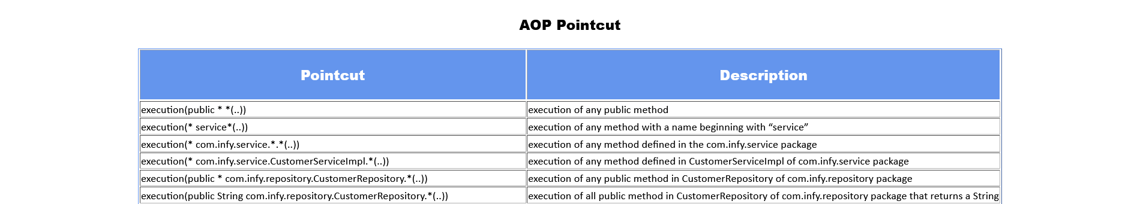

Slide 123
Configuring AOP in Spring Boot
To use Spring AOP and AspectJ in Spring Boot project you have to add spring-boot-starter-aop starter in pom.xml file as follows:
<dependency>
<groupId>org.springframework.boot</groupId>
<artifactId>spring-boot-starter-aop</artifactId>
</dependency>
This starter adds following key dependencies:
Spring AOP which provides basic AOP capabilities
AspectJ which provides a complete AOP framework
Now let us see how you can use Spring AOP for implementing different types of advices.

Slide 124
Implementing AOP advices
Before advice
This advice is invoked before the actual method call. It is declared using @Before annotation. The following is an example of this advice:
@Before("execution(* com.hnd.service.*Impl.*(..))")
public void before() throws hndBankException {
LOGGER.info("Before advice called.");
}
This advice is executed before execution of methods of classes present in com.hnd.service package and whose name ends with Impl.
After Advice
This advice is executed after the execution of the actual method, even if it throws exception during execution. It is commonly used for resource cleanup such as temporary files or closing database connections. It is declared using @After annotation. The following is an example of this advice :

Slide 125
@After("execution(* com.hnd.service.*Impl.*(..))")
public void after() throws hndBankException {
LOGGER.info("After advice called.");
}
This advice is executed after execution of methods of classes present in com.hnd.service package and whose name ends with Impl.
Note: @Before, @After and other annotations for the advice methods are imported from org.aspectj.lang.annotation
After Returning Advice
This advice gets executed after joinpoint finishes its execution. If the target method throws an exception the advice is not executed. It is declared using @AfterReturning annotation. The following is an example of this advice that is executed after methods of classes whose name ends with Impl in com.hnd.service package finishes its execution:

Slide 126
@AfterReturning("execution(* com.hnd.service.*Impl.*(..))")
public void afterReturning() throws hndBankException {
LOGGER.info("After returning advice called.");
}
You can also access the value returned by the joinpoint by defining returning attribute of @AfterReturning annotation as follows:
@AfterReturning(value = "execution(* com.hnd.service.*Impl.*(..)),returning = "returnvalue"")
public void afterReturning(String returnvalue) throws hndBankException {
LOGGER.info("After returning advice called.");
}
In above code snippet, the value of the returning attribute is returnvalue which matches with the name of the advice method argument.

Slide 127
After Throwing Advice
This advice gets executed after an exception is thrown from target method. It is defined using @AfterThrowing annotation. The following is an example of this advice that gets executed when exceptions are thrown from methods of all the classes of com.hnd.service package whose name ends with Impl. So it is marked with @AfterThrowing annotation as follows:
@AfterThrowing(pointcut = "execution(* com.hnd.service.*Impl.*(..))", throwing = "exception")
public void afterThrowing(hndBankException exception) throws hndBankException {
LOGGER.error(exception.getMessage(), exception);
}
@AfterThrowing annotation has following two attributes:
pointcut attribute is pointcut expression which defines when advice is executed.
throwing attribute is used to access the exception thrown from target method inside the advice method. Its must match with the name of Exception argument passed to advice method.

Slide 128
Around advice
This advice gets executed around the join point i.e. before and after the execution of the target method. It is declared using @Around annotation. The following is an example of this advice:
@Around("execution(* com.hnd.service.*Impl.*(..))")
public void aroundAdvice(ProceedingJoinPoint proceedingJoinPoint) throws Throwable {
LOGGER.info("Before proceeding part of the Around advice.");
proceedingJoinPoint.proceed();
LOGGER.info("After proceeding part of the Around advice.");
}
In above code snippet aroundAdvice method accepts an instance of ProceedingJoinPoint as parameter. It extends the JoinPoint interface, and it can only be used in the Around advice. The proceed() method invokes the joinpoint.

Slide 129
Implementing AOP Advices - Demo
Objective:
To implement Aspect Oriented Programming advices
Steps:
Step 1: Import the previous demo which was done for implementing Logging in Spring Boot application.
Step 2: Add the following Spring Boot starter dependency in pom.xml.
<dependency>
<groupId>org.springframework.boot</groupId>
<artifactId>spring-boot-starter-aop</artifactId>
</dependency>

Slide 130
Step 3: Add a new package com.hnd.utility in src/main/java.
Step 4: Create a new class LoggingAspect.java in the above created package. Annotate the class with @Component and @Aspect annotations.
Step 5: Complete the class with the following code for advice methods.
import org.apache.commons.logging.Log;
import org.apache.commons.logging.LogFactory;
import org.aspectj.lang.annotation.After;
import org.aspectj.lang.annotation.AfterReturning;
import org.aspectj.lang.annotation.AfterThrowing;
import org.aspectj.lang.annotation.Aspect;
import org.aspectj.lang.annotation.Before;
import org.springframework.stereotype.Component;
import com.hnd.exception.hndBankException;

Slide 131
@Component
@Aspect
public class LoggingAspect {
public static final Log LOGGER = LogFactory.getLog(LoggingAspect.class);
@Before("execution(* com.hnd.service.*Impl.*(..))")
public void before() throws hndBankException {
LOGGER.info("Before advice called.");
}
@After("execution(* com.hnd.service.*Impl.*(..))")
public void after() throws hndBankException {
LOGGER.info("After advice called.");
}
@AfterReturning("execution(* com.hnd.service.*Impl.*(..))")
public void afterReturning() throws hndBankException {
LOGGER.info("After returning advice called.");
}
@AfterThrowing(pointcut = "execution(* com.hnd.service.*Impl.*(..))", throwing = "exception")
public void afterThrowing(hndBankException exception) throws hndBankException {
LOGGER.error(exception.getMessage(), exception);
}
}

Slide 132
Step 6: Execute the DemoSpringBootCoreApplication.java class
Best Practices in Spring Boot
Some of the best practices that should be followed while developing with Spring Boot are:
Use Spring Initializr for creating a Spring Boot application
As you have already seen, there are different possible ways for creating Spring Boot application but, using Spring Initializr for creating new Spring Boot application is considered as a best practice.
What can be the possible reasons for this?
This is because Spring Initializr gives an easy way to start a new Spring Boot project and load it with the dependencies that the developer is in need of. Also, creating an application using Spring Initializr ensures that already tested dependencies are added to the application. This helps in auto-configuration as well since the appropriate dependencies are added.

Slide 133
Use Auto-configuration
One of the main features of Spring Boot is auto-configuration.
Usage of auto-configuration is considered to be a best practice as it makes your code simply work. Whenever a jar file is detected on the classpath, it gets activated. The simplest way to achieve this is to depend on the Spring Boot Starters as we have already done.
Depending on the starters make sure that the latest dependencies are added and it helps in avoiding issues related to the them.
Suppose, if you want to have AOP, you just have to add the starter dependency in your pom.xml file.
<dependency>
<groupId>org.springframework.boot</groupId>
<artifactId>spring-boot-starter-aop</artifactId>
</dependency>

Slide 134
Avoid Spring Boot Framework in Business Logic
With the introduction to Spring and Spring Boot framework, it may be attractive to use it anywhere and everywhere possible. Before jumping into that conclusion, let us understand where we should not needlessly insert the Spring Boot framework.
The most important places, rather classes where Spring Boot features must not be added are the classes implementing the business logic. One of the biggest example of this are the validation classes. Introducing Spring Boot framework here is unwanted and may lead to unnecessary complications.

